Slide 1
Using Advanced Options
Microsoft Word 2013
Lesson 14

Slide 2
Objectives

Slide 3
Step by Step: Personalize Word
GET READY. Before you begin these steps, be sure to LAUNCH Microsoft Word.
OPEN the A Datum document from the lesson folder.
Click the File tab, and then click the Options button to display the Word Options screen.
The General options is already selected.
In the Personalize your copy of Microsoft Office section, type [your name] in the User name box and [your initials] in the Initials box. Your name and initials appear only here.
Click OK.
Open Backstage and notice the Properties area on the right side.
Notes:
Cross Reference: In Lesson 9, you learn to change a user’s name in the Track Changes Options dialog box.

Slide 4
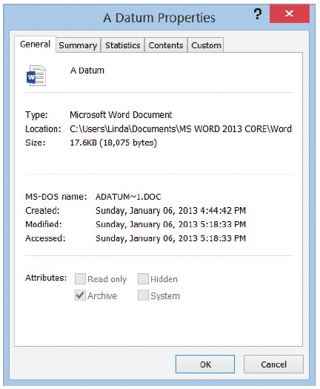
Step by Step: Personalize Word
It displays the properties of the document size, pages, words, editing time, date the document was created or modified, and author and any other person who might have reviewed the document.
Display the Advanced Properties by clicking the drop-down arrow under Properties, and then select Advanced Properties. The Advanced Properties dialog box opens as shown at right.
Notes:
Cross Reference: In Lesson 2, you learn to display the document panel to show above the document and open the Advanced Properties. You can also display the Advanced Properties from Backstage.

Slide 5
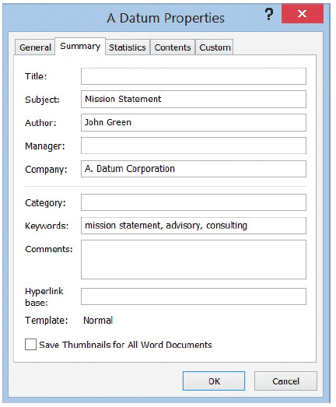
Step by Step: Personalize Word
Click the Summary tab to add information that describes your document.
Data that describes other data is called metadata. Adding information in the properties is also known as metadata, which includes details about the document.
Type the information as shown at right, and then click OK.

Slide 6
Step by Step: Personalize Word
Select Show All Properties at the bottom of the Properties pane.
Review the updated properties in Backstage to see the author’s name and tags.
Return to the document.
PAUSE. LEAVE the document open to use in the next exercise.

Slide 7
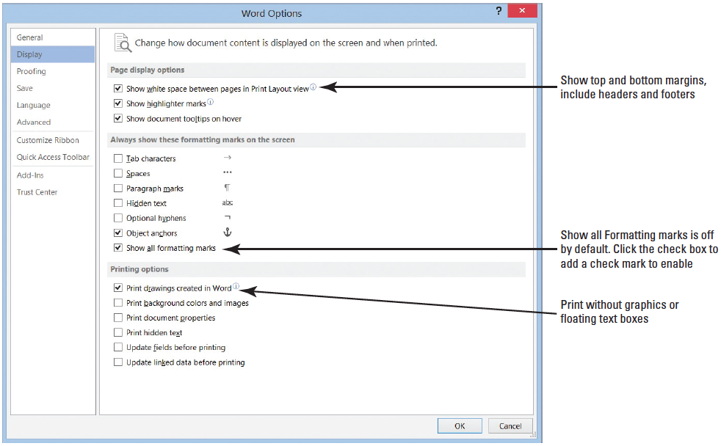
Step by Step: Change Display Options
USE the document that is open from the previous exercise.
Click the File tab, and then click the Options button to display the Word Options.
Click Display to view the display options, shown at right.

Slide 8
Step by Step: Change Display Options
In the Always show these formatting marks on the screen section, the check box is empty beside the Show all formatting marks.
Click to add a check mark next to Show all formatting marks.
Click OK.
Notice that the paragraph marks are appearing in the document.
Open the Display screen and click to remove the check mark by Show all formatting marks. By default, this feature is disabled.
Click OK.
CLOSE the document without saving.
PAUSE. LEAVE Word open to use in the next exercise.

Slide 9
Step by Step: Turn AutoFormat Off or On
OPEN the A Datum Security Alarm document from the lesson folder.
Click the File tab, and then click Options.
Click Proofing to display the options.
Click the AutoCorrect Options button, and then click the AutoFormat As You Type tab.
Under the Apply As You Type section, select the check box by Automatic Bulleted Lists to clear (an empty check mark indicates the feature is off).

Slide 10
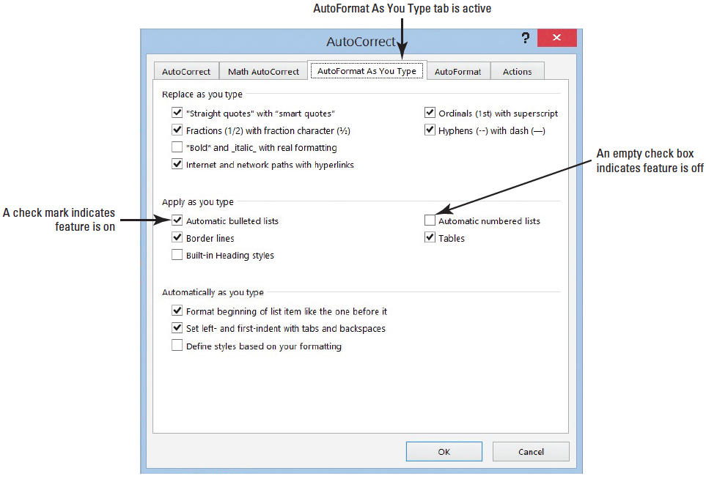
Step by Step: Turn AutoFormat Off or On
Click again to place a check mark in the box to turn Automatic Bulleted Lists back on (below).
Click OK to close the AutoCorrect dialog box, and then click OK to close the Word Options screen.

Slide 11
Step by Step: Turn AutoFormat Off or On
Position the insertion point after the last bulleted item and press Enter twice to clear the bullet list.
On the Page Layout tab, in the Page Setup group, select Continuous from the Line Numbers command, and then place the insertion point on line 14.
Type ~ ~ ~ three times and press Enter. A wavy border line is placed Sacross the page.
Access the Proofing screen and click the AutoCorrect Options button.
Add a check mark by *Bold* and _italic_ with real formatting to enable this feature.

Slide 12
Step by Step: Turn AutoFormat Off or On
Click OK separately to close both dialog boxes.
On line 26, select Ready and type *Ready*. The text is automatically bolded.
In the AutoCorrect Options, remove the check mark by *Bold* and _italic_ with real formatting.
SAVE the document as Security Alarm Update in the lesson folder on your flash drive, and then CLOSE the file.
PAUSE. LEAVE the document open to use in the next exercise.
Notes:
Cross Reference: In Lesson 9, you learn about accessing the AutoCorrect Options.

Slide 13
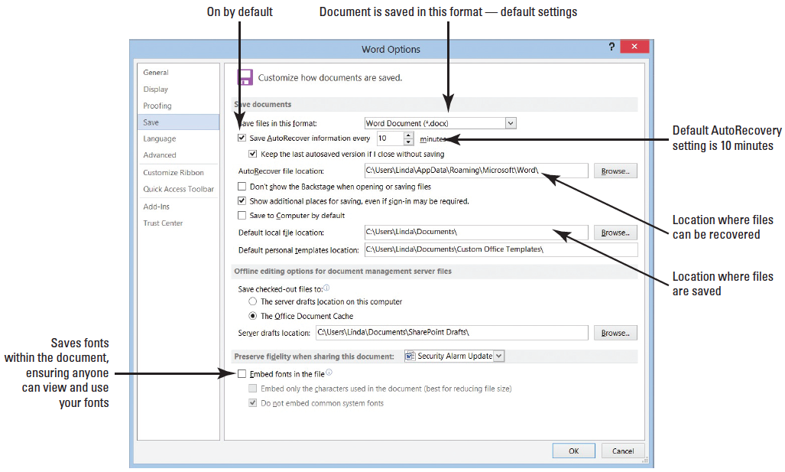
Step by Step: Set Save Options
OPEN a blank document.
Click the File tab, and then click Options.
Click Save to display the Save options screen as shown at right.

Slide 14
Step by Step: Set Save Options
In the Save documents section, click the drop-down arrow in the Save files in this format box.The menu displays the options available for changing the default file format used when saving backup files. The default setting to save your work is set to every 10 minutes.
In the Save AutoRecover information every box, change the settings to 3.
Your documents will be saved every three minutes. Check with your instructor before changing the settings. If you change the settings, don’t forget to return the setting back to its default.
LEAVE the Word Options dialog box open for the next exercise.
PAUSE. LEAVE Word open to use in the next exercise.
Notes:
Take Note: Any change made to the default working folder applies only to the application that you are currently using. For example, if a different default working folder is selected for Word, the default working folder for Excel remains Documents if you are using Windows 8 or Windows 7.

Slide 15
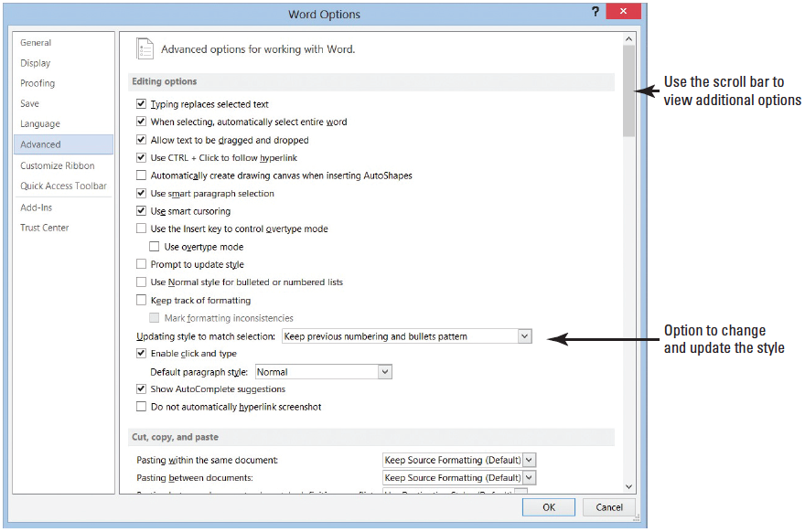
Step by Step: Use Advanced Options
USE the document open from the previous exercise.
From the Word Options dialog box, click Advanced to display the Advanced options.
There are several advanced options, many of which are shown above and in the next three figures.

Slide 16
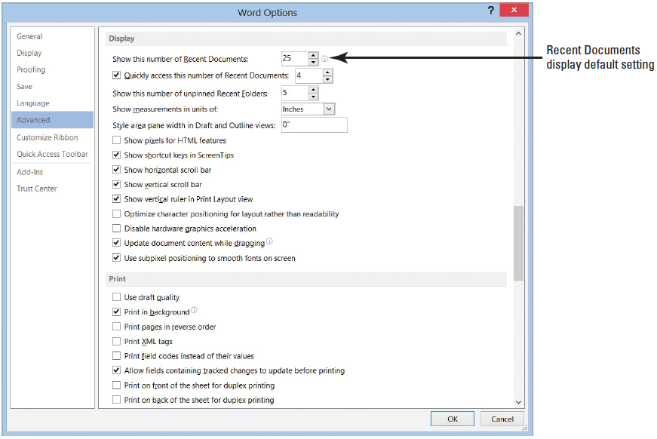
Step by Step: Use Advanced Options
Scroll down and locate the Display section (shown at right); click the down arrow next to the number in the Show this number of Recent Documents list box to change it from 25 to 10.

Slide 17
Step by Step: Use Advanced Options
Click OK.
Click the File tab, and then click Open. Ten documents display under Recent Documents.
Return the settings back to default, and leave the Word Options dialog box open.

Slide 18
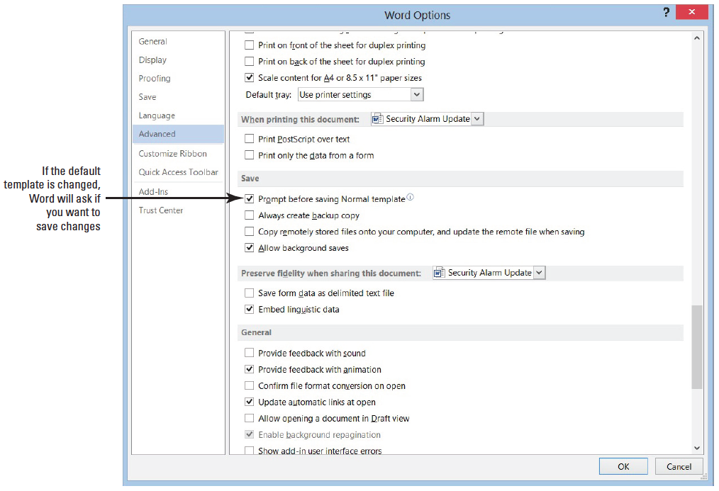
Step by Step: Use Advanced Options
Scroll down to the Save section (right) and click the check box to enable Prompt before saving Normal template. Now if you change the default template, Word will prompt you if you want to save the changes to that template.

Slide 19
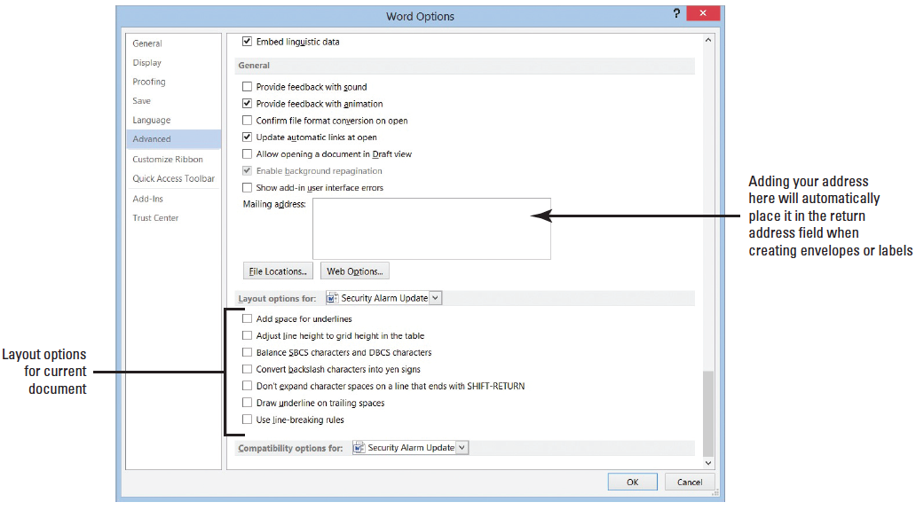
Step by Step: Use Advanced Options
Scroll down to the General section (shown at right) and type [your name and address] in the Mailing address box.
Click OK.
Open a blank document.
Notes:
Another Way: The keyboard shortcut Ctrl+N opens a new blank document.

Slide 20
Step by Step: Use Advanced Options
On the Mailings tab, in the Create group, click the Envelopes button.
In the Envelopes and Labels dialog box, notice that your name and address appear in the Return address area.
Click Cancel.
Return to the General section and remove your name, and then remove the check mark by Prompt before saving Normal template under the Save section.
PAUSE. LEAVE Word open to use in the next exercise.

Slide 21
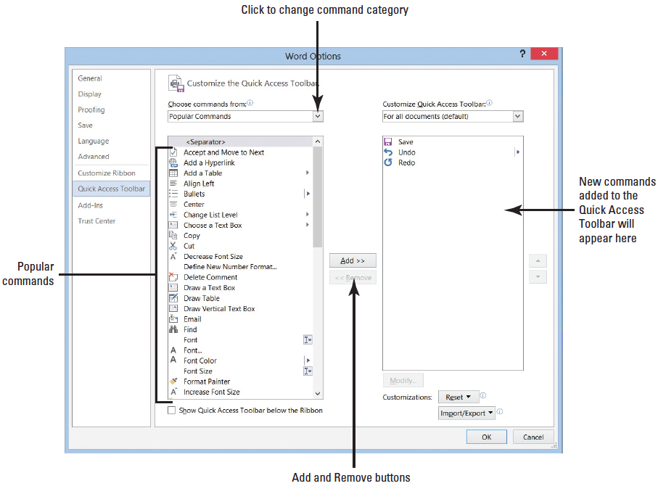
Step by Step: Customize the Quick Access Toolbar
USE the document open from the previous exercise.
Click the File tab, and then click Options.
Click the Quick Access Toolbar to display the customization options, shown at right.
Notes:
Cross Reference: You ﬁrst learn about the Quick Access Toolbar in Lesson 1.

Slide 22
Step by Step: Customize the Quick Access Toolbar
In the Choose commands from list, Popular Commands is already selected.
Scroll down the list of commands, and select Page Setup, and then click the Add button.
Select Page Width, and then double-click to quickly add to the Customize Quick Access Toolbar. Repeat the step for the Numbering command.
Click OK. The Quick Access Toolbar is now customized with new commands and easily accessible. Check with your instructor if these commands should remain on the toolbar.
PAUSE. LEAVE Word open to use in the next exercise.
Notes:
Another Way: You can open the customization screen using the Quick Access Toolbar, More Commands.
Take Note: To remove a command from the Quick Access Toolbar, place the insertion point on the command in the Quick Access Toolbar, right-click the command, and then click Remove from Quick Access Toolbar.

Slide 23
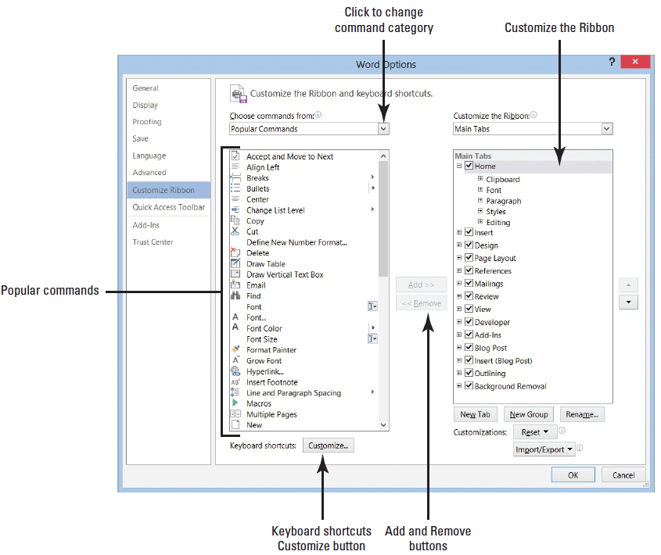
Step by Step: Customize the Keyboard
USE the document open from the previous exercise.
Open the Word Options dialog box, and click Customize Ribbon to open the customization screen (right)
On the bottom left, click the Customize button next to Keyboard shortcut.

Slide 24
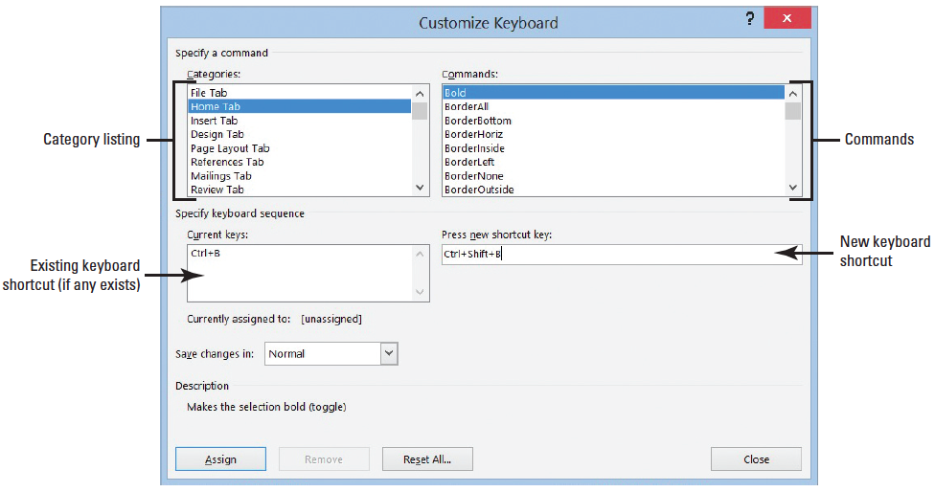
Step by Step: Customize the Keyboard
The Customize Keyboard dialog box appears (below).
In the Categories box, click Home Tab.
You should see Bold highlighted under the Commands box.
One shortcut key command appears in the Current keys box. The Ctrl+B command is a reserved key and assigned to the Bold command.

Slide 25
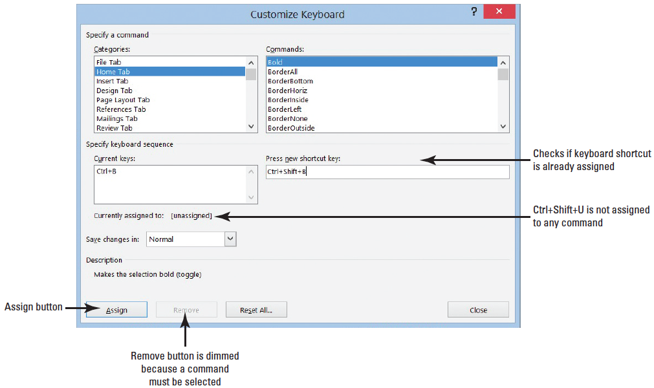
Step by Step: Customize the Keyboard
In the Press new shortcut key box, type Ctrl+Shift+B as shown below. Under the Current keys box, it shows that this command is [unassigned].
Click the Assign button.

Slide 26
Step by Step: Customize the Keyboard
Return to the Word screen and type any word, and then select and press Ctrl+Shift+B. The text should be bolded.
Open the Customize Keyboard dialog box, select the Home tab. The two shortcut key commands appear in the Current keys box.
Select Ctrl+Shift+B, and then click the Remove button to remove the shortcut key. Removing Ctrl+Shift+B now makes it available to be used for another shortcut keyboard command.
Click Close to close the Customize Keyboard dialog box.
Leave the Word Options dialog box open for the next exercise.
PAUSE. LEAVE Word open to use in the next exercise.
Notes:
Another Way: You can also add an item to the Quick Access Toolbar by clicking the Customize Quick Access Toolbar button or by right-clicking anywhere on the bar.

Slide 27
Step by Step: Customize the Ribbon
In this exercise, you create a customized Ribbon, place your favorite commands in one location, and group them.
You can add commands already found on other tabs, and you also have the option to place commands not found in any of the tabs.
USE the document open from the previous exercise.
Access Word Options, and then click Customize Ribbon to open the customization screen (see next slide).
Under Main Tabs, click the minus (-) sign to collapse the groups listed under Home. The Home Tab should appear selected.

Slide 28
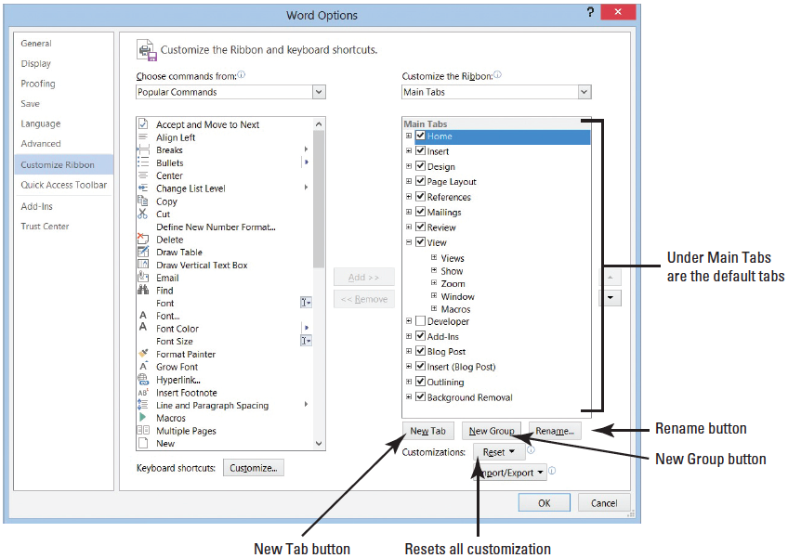
Step by Step: Customize the Ribbon

Slide 29
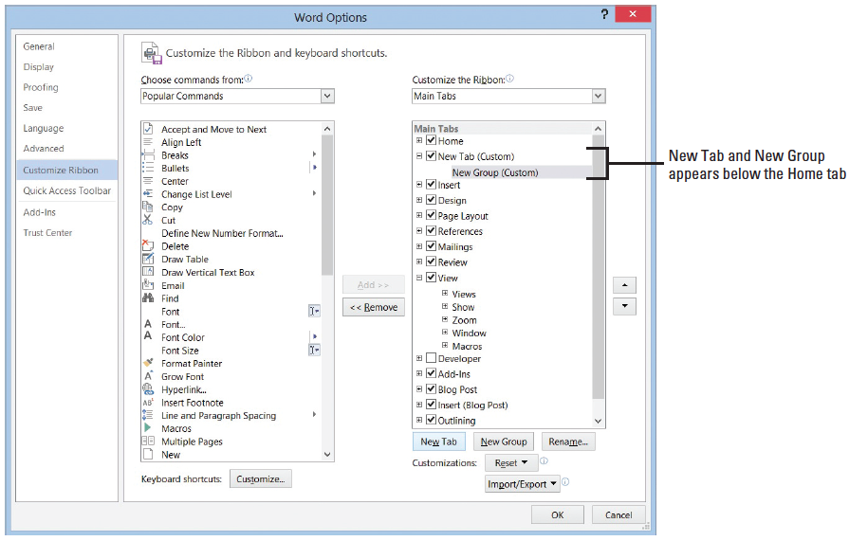
Step by Step: Customize the Ribbon
Click the New Tab button. Two objects appear: one is identified for the new tab whereas the other is for the group as shown below.

Slide 30
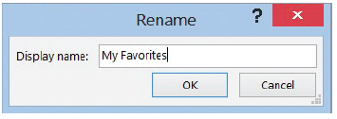
Step by Step: Customize the Ribbon
Select New Tab (Custom), and then click the Rename button. The Rename dialog box appears.
Type My Favorites in the box (below).
Click OK.
Select New Group (Custom), and then click the Rename button. The Rename dialog box appears with icons to identify your command group.
Type My Commands.

Slide 31
Step by Step: Customize the Ribbon
Select the smiley face.
Click OK. With My Commands selected, you are ready to add commands in this group.
Under the Popular Commands, select then click the Add button to place in My Commands.
Select Accept and Move to Next, and then click the Add button. This command is placed under My Commands.

Slide 32
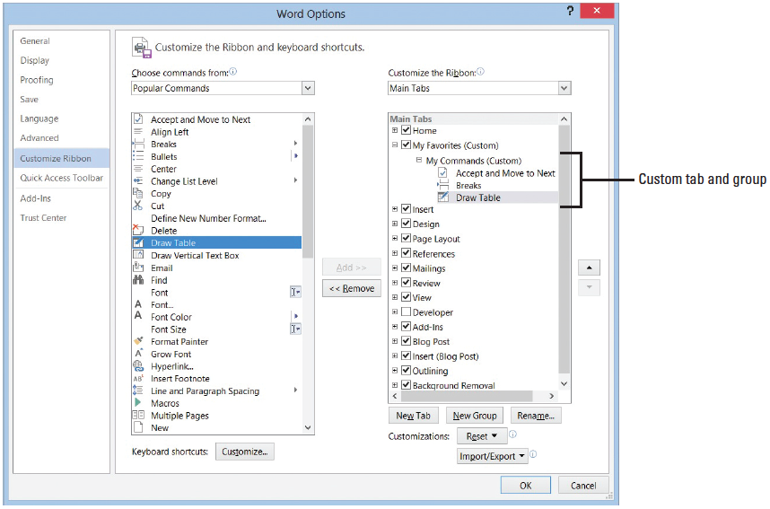
Step by Step: Customize the Ribbon
Select Breaks and Draw Table separately, and then click the Add button. Your screen should match the figure below.

Slide 33
Step by Step: Customize the Ribbon
Click OK.
Click the My Favorites tab and review your customized tab and group of commands (see below).
To remove the customized tab, return to the customization screen, and then click the Reset button.
STOP. CLOSE Word.

Slide 34
Skill Summary

